Slide 1
Support Vector Machine

Slide 2
Linear Support Vector Machine
Find a linear boundary
  Two class problem

Slide 3
Linear Support Vector Machine
How about this?
  Correct boundary.. Good or Bad?

Slide 4
Linear Support Vector Machine
How about this?
  Correct boundary.. Good or Bad?

Slide 5
Linear Support Vector Machine
Any of these would be find.. But
  Which is best??

Slide 6
Linear Support Vector Machine
Which boundary is better?
Which boundary is more “in between” class ?
How can you evaluate the in-bewteen-ness ?

Slide 7
Linear Support Vector Machine
Margin of a linear classifier
  the width that the boundary could be increased by before
  hitting a datapoint

Slide 8
Linear Support Vector Machine
Why?
  RED or Blue ?
Based on the intuition, which class may it
belong to?
Based on the boundary, which class may it
belong to?
Unknown
data point

Slide 9
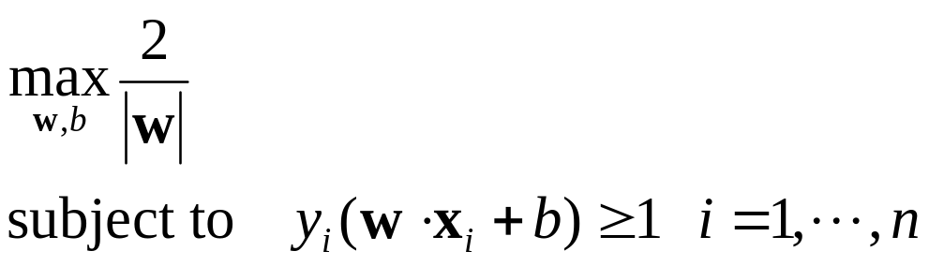
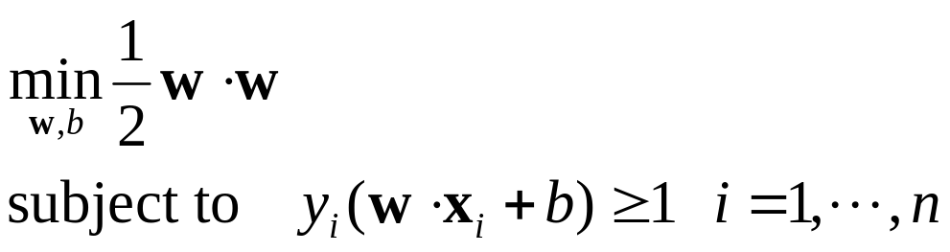
Learning Linear SVM
Formalization of LSVM
  When we have
  or

Slide 10
Linear SVM with Soft Margin
Non-Linearly Separable Problem
  Impossible to find a linear boundary without error
Let’s allow ERROR

Slide 11
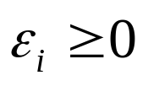
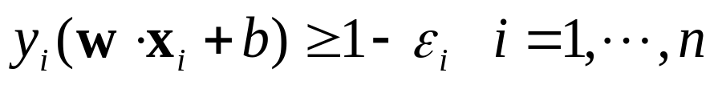
Linear SVM with Soft Margin
Let’s assume error, , for each data x_{i}
so that
ε₁₁
ε₂
ε₇
wx+b=1
wx+b=0
wx+b=-1
Find a linear boundary which
maximizes the margin
minimizes the error

Slide 12
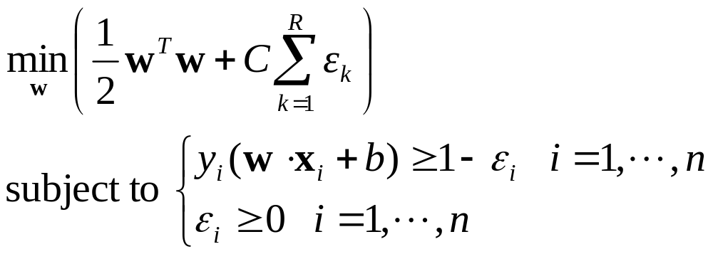
Linear SVM with Soft Margin
Formulation
  C : given by experts, controlling overfitting
Margin
Error
Slack variable

Slide 13

Linear SVM with Soft Margin
Effect of C
  C = infinite
    No allowance for error -> Narrow margin
    Equivalent to hard margin SVM
    Over-fitting
  C = 0
    Maximum allowance for error -> Maximum margin
    Over-generalization

Slide 14
Linear SVM with Soft Margin
Effect of C
  C = infinite : No allowance for error
Support vectors
- a data point with α > 0

Slide 15
Linear SVM with Soft Margin
Effect of C
  C = Some Value: Some allowance for error
    # of support vectors increases as C becomes small
Support vectors
- a data point with 0 < α < C
- a data point with α = C

Slide 16
Non-Linear SVM
General idea
  the original input space can always be mapped to some higher-dimensional feature space where the training set is separable:
Φ: X → Y
y=Φ(x)
X
Y

Slide 17









Kernel Trick
Kernel
  A function that corresponds to a dot product of two feature vectors in some expanded feature space
  You have two functions
  and it happens that
  Then, K is called a kernel function

Slide 18
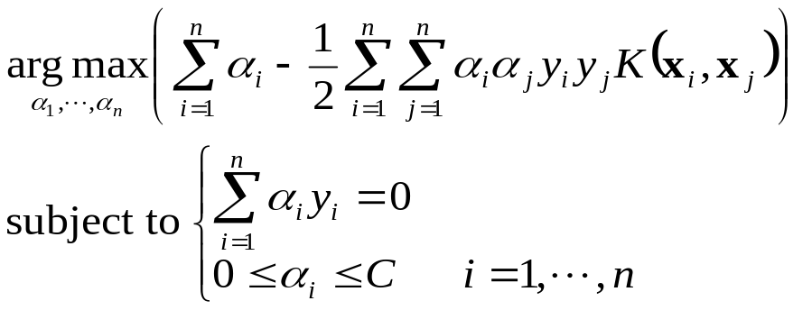
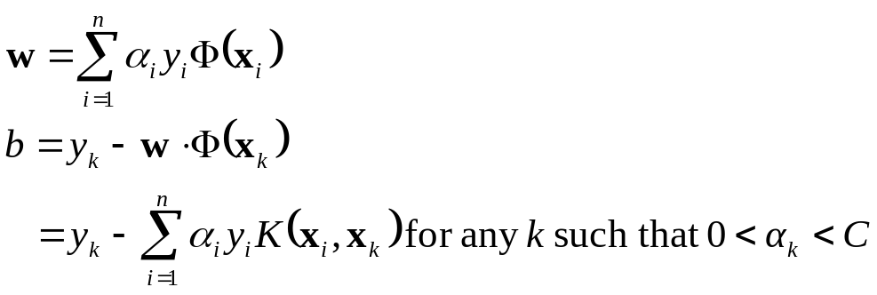
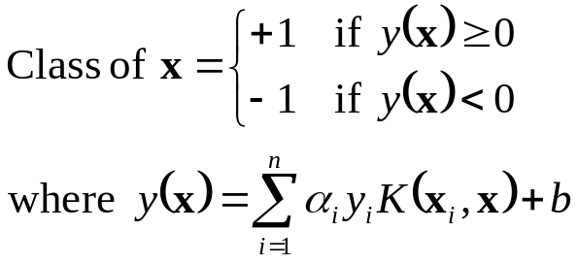
Kernel Trick
Final Formulation of SVM
  For given
  Choose C and K, and Solve
  Solution for the boundary
For unknown x

Slide 19



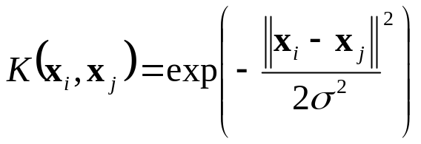

Some More on Kernels
Examples of commonly-used kernel functions:
  Linear Kernel
  Homogeneous Polynomial Kernel
  Polynomial Kernel
  Gaussian Kernel (RBF Kernel)
  Sigmoid Kernel

